Slide 1
Fourier Neural Operators Han Zhang

Slide 2
Contents
Introduction & Motivation
Theory & Methodology
Experiments & Results

Slide 3
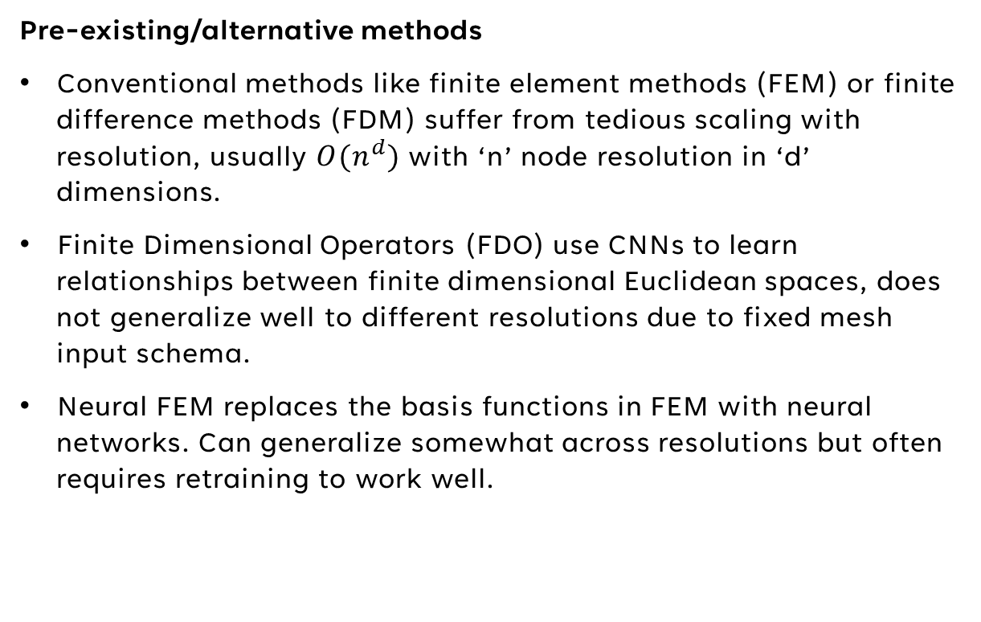
Motivation
Pre-existing/alternative methods
Conventional methods like finite element methods (FEM) or finite difference methods (FDM) suffer from tedious scaling with resolution, usually $O(n^{d})$ with ‘n’ node resolution in ‘d’ dimensions.
Finite Dimensional Operators (FDO) use CNNs to learn relationships between finite dimensional Euclidean spaces, does not generalize well to different resolutions due to fixed mesh input schema.
Neural FEM replaces the basis functions in FEM with neural networks. Can generalize somewhat across resolutions but often requires retraining to work well.

Slide 4
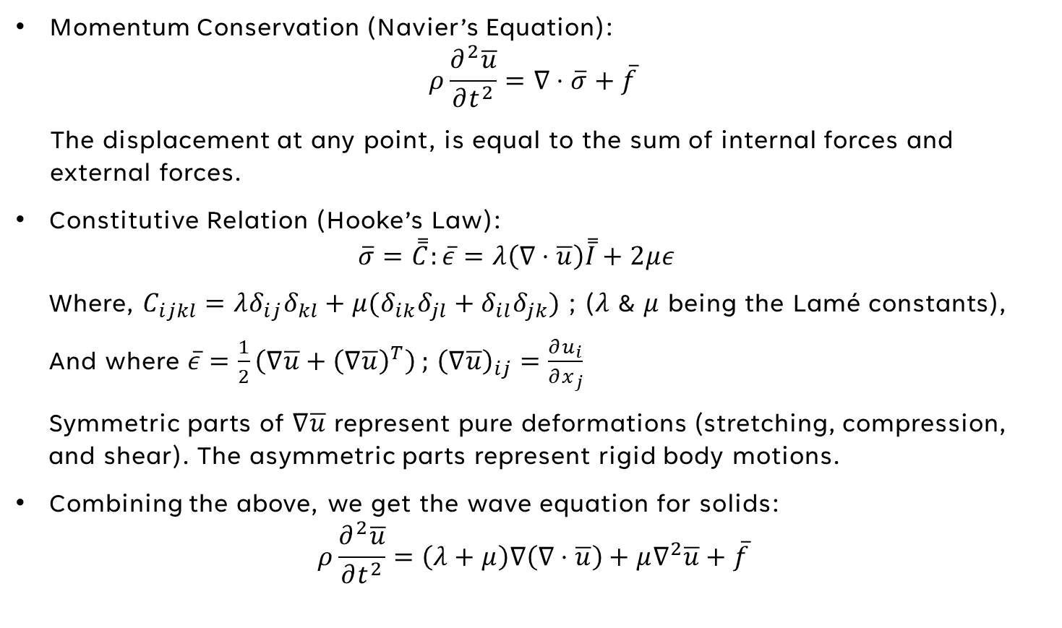
Governing Equations – Solid Acoustics
Momentum Conservation (Navier’s Equation):
$$ρ\frac{∂^{2}\overline{u}}{∂t^{2}}=∇⋅\overline{σ}+\overline{f}$$
The displacement at any point, is equal to the sum of internal forces and external forces.
Constitutive Relation (Hooke’s Law):
$$\overline{σ}=\overset{̿}{C}:\overline{ε}=λ\left(∇⋅\overline{u}\right)\overset{̿}{I}+2με$$
Where, $C_{ijkl}=λδ_{ij}δ_{kl}+μ(δ_{ik}δ_{jl}+δ_{il}δ_{jk})$ ; ($λ$ & $μ$ being the Lamé constants),
And where $\overline{ε}=\frac{1}{2}\left(∇\overline{u}+{\left(∇\overline{u}\right)}^{T}\right)$ ; ${\left(∇\overline{u}\right)}_{ij}=\frac{∂u_{i}}{∂x_{j}}$
Symmetric parts of $∇\overline{u}$ represent pure deformations (stretching, compression, and shear). The asymmetric parts represent rigid body motions.
Combining the above, we get the wave equation for solids:
$$ρ\frac{∂^{2}\overline{u}}{∂t^{2}}=\left(λ+μ\right)∇\left(∇⋅\overline{u}\right)+μ∇^{2}\overline{u}+\overline{f}$$

Slide 5
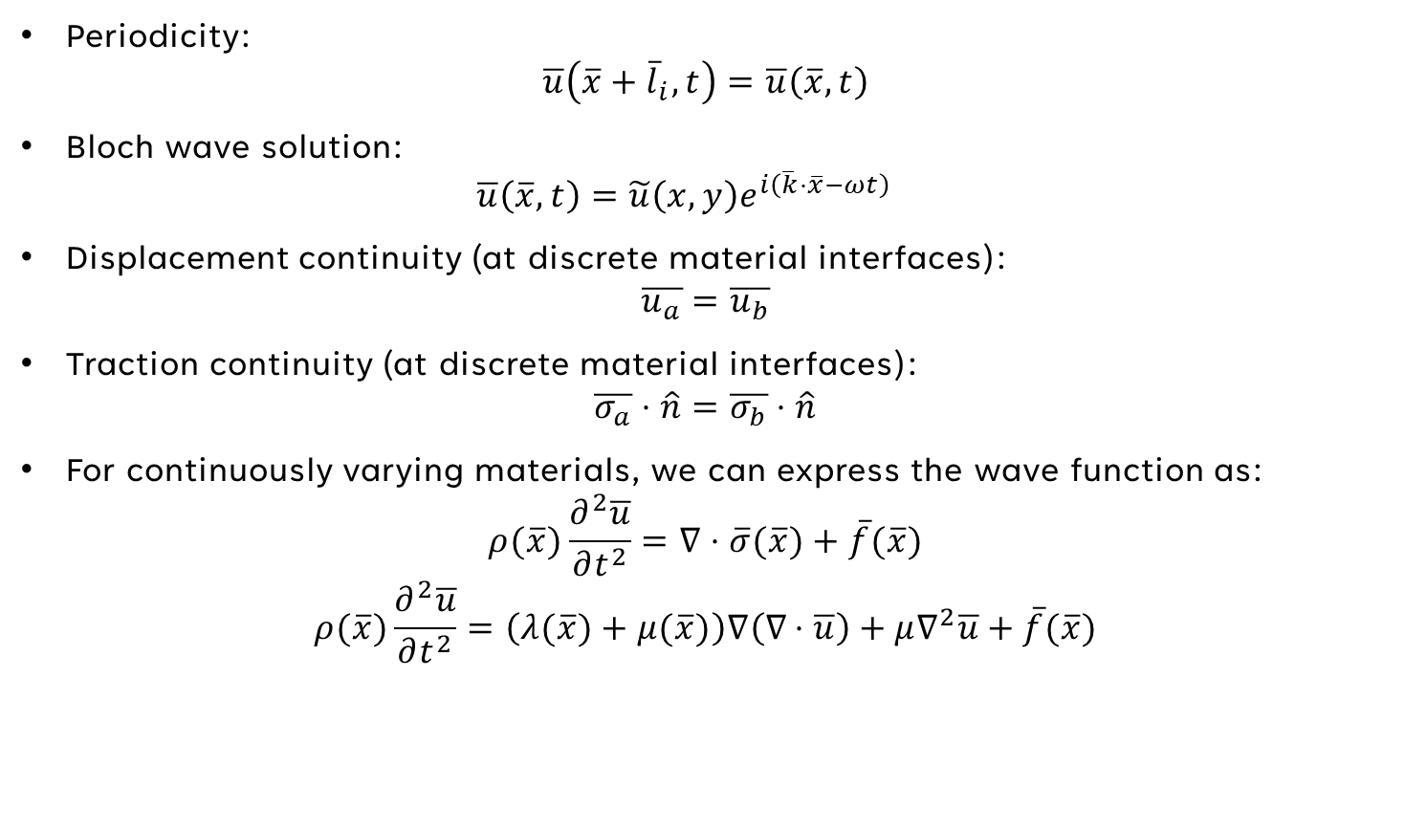
Governing Equations – Boundary Conditions
Periodicity:
$$\overline{u}\left(\overline{x}+{\overline{l}}_{i}, t\right)=\overline{u}\left(\overline{x},t\right)$$
Bloch wave solution:
$$\overline{u}\left(\overline{x},t\right)=\tilde{u}\left(x,y\right)e^{i\left(\overline{k}⋅\overline{x}−ωt\right)}$$
Displacement continuity (at discrete material interfaces):
$$\overline{u_{a}}=\overline{u_{b}}$$
Traction continuity (at discrete material interfaces):
$$\overline{σ_{a}}⋅\hat{n}=\overline{σ_{b}}⋅\hat{n}$$
For continuously varying materials, we can express the wave function as:
$$ρ(\overline{x})\frac{∂^{2}\overline{u}}{∂t^{2}}=∇⋅\overline{σ}(\overline{x})+\overline{f}(\overline{x})$$
$$ρ(\overline{x})\frac{∂^{2}\overline{u}}{∂t^{2}}=\left(λ(\overline{x})+μ(\overline{x})\right)∇\left(∇⋅\overline{u}\right)+μ∇^{2}\overline{u}+\overline{f}(\overline{x})$$

Slide 6
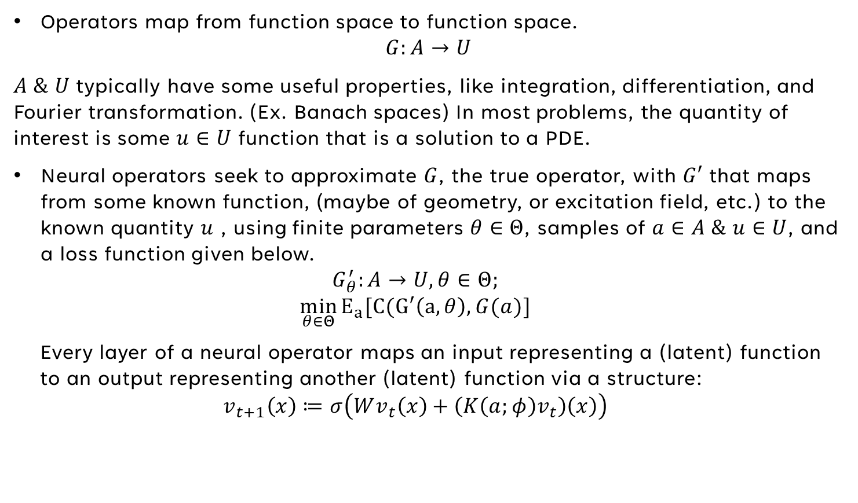
Neural Operators
Operators map from function space to function space.
$$G:A→U$$
$A \& U$typically have some useful properties, like integration, differentiation, and Fourier transformation. (Ex. Banach spaces) In most problems, the quantity of interest is some $u∈U$ function that is a solution to a PDE.
Neural operators seek to approximate $G$, the true operator, with $G′$ that maps from some known function, (maybe of geometry, or excitation field, etc.) to the known quantity $u$ , using finite parameters $θ∈Θ$, samples of $a∈A \& u∈U$, and a loss function given below.
$$G_{θ}^{′}:A→U, θ∈Θ;$$
$$\min_{θ∈Θ}{E_{a}[C(G′\left(a,θ\right),G(a)]}$$
Every layer of a neural operator maps an input representing a (latent) function to an output representing another (latent) function via a structure:
$$v_{t+1}\left(x\right)≔σ\left(Wv_{t}\left(x\right)+\left(K\left(a;φ\right)v_{t}\right)\left(x\right)\right)$$

Slide 7
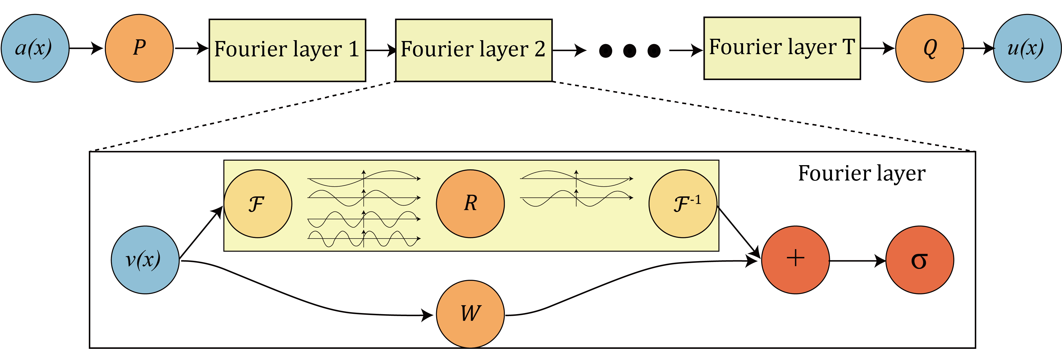
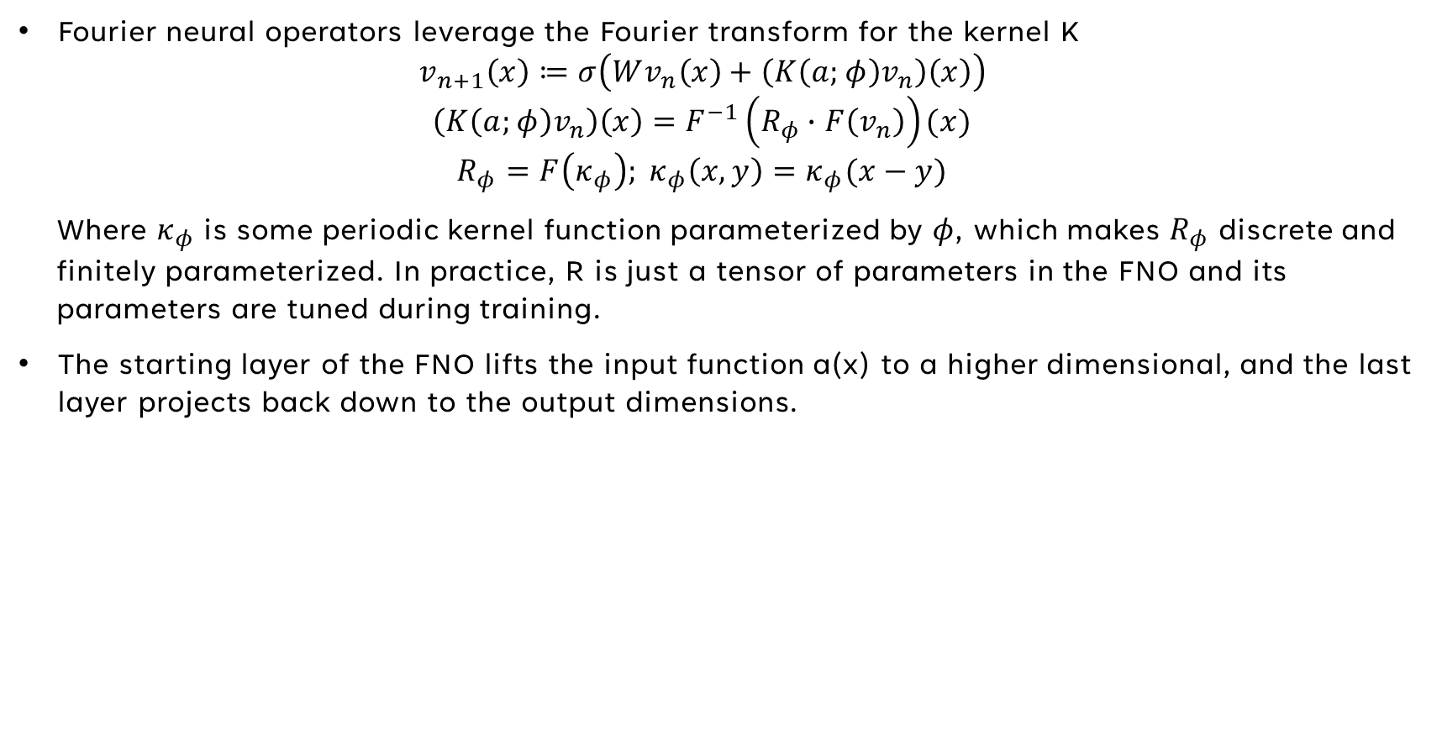
Fourier Neural Operators
Fourier neural operators leverage the Fourier transform for the kernel K
$$v_{n+1}\left(x\right)≔σ\left(Wv_{n}\left(x\right)+\left(K\left(a;φ\right)v_{n}\right)\left(x\right)\right)$$
$$\left(K\left(a;φ\right)v_{n}\right)\left(x\right)=F^{−1}\left(R_{φ}∙F\left(v_{n}\right)\right)(x)$$
$$R_{φ}=F\left(κ_{φ}\right); κ_{φ}\left(x,y\right)=κ_{φ}(x−y)$$
Where $κ_{φ}$ is some periodic kernel function parameterized by $φ$, which makes $R_{φ}$ discrete and finitely parameterized. In practice, R is just a tensor of parameters in the FNO and its parameters are tuned during training.
The starting layer of the FNO lifts the input function a(x) to a higher dimensional, and the last layer projects back down to the output dimensions.
Li, Z et al. (2021)

Slide 8
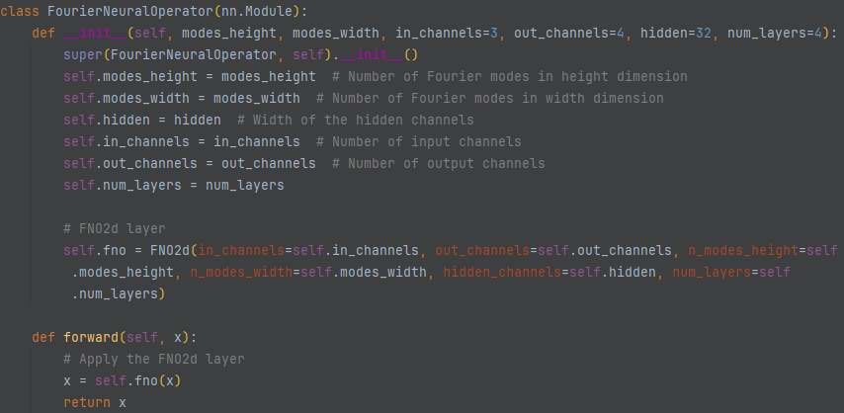
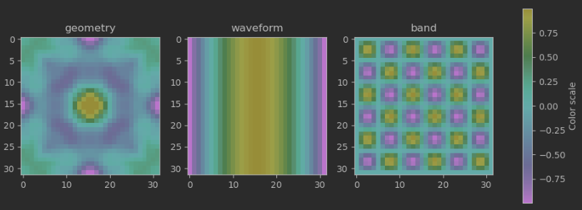
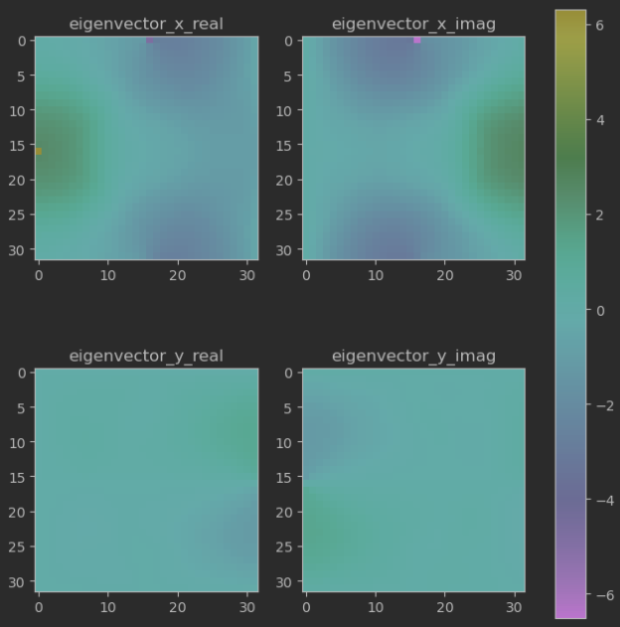
Fourier Neural Operators - Implementation
modes_height = modes_width = 32 (allows for 32 spatial frequencies in the x and y dimension)
in_channels = 3, out_channels = 4 (3 input images, 4 output images)
hidden_channels = 64 (model param size approx. scales quadratically with this param)
num_layers = 4 (in literature, 4 has been sufficient for most applications)

Slide 9
Results
Zero-shot super-resolution: Navier Stokes Equation, trained on 64x64x20 dataset, evaluated on 256x256x80
Benchmarks on three PDE problems, trained and tested on the same resolution.
1000 training samples, 200 test samples, 500 epochs of (ADAM) training, 4 layer FNO
Figures from Li, Z et al.’s 2021 paper on FNOs

Slide 10
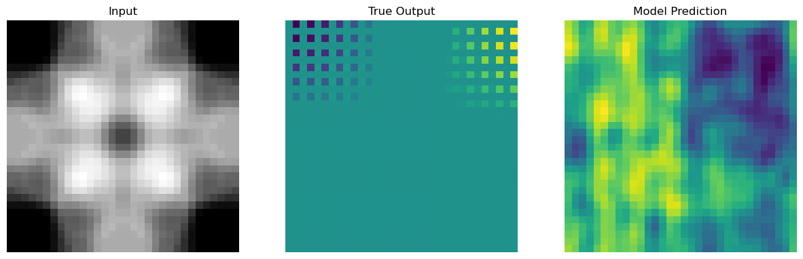
Troubleshooting
Currently using Neuralop package to build & train FNO neural operator.
Inputs: geometry; Outputs: eigenvector x component; Fixed: wavevector
Suspect the neural network is not properly transforming the input space.
Suspect there are other inputs necessary for network to learn, like wavevector.
Suspect it may be easier to learn eigenvector magnitude over one component
Train/test on one sample to see if model can learn just one representation.
Swap to eigenvector magnitude to see if it can learn that. Then try x & y.

Slide 11
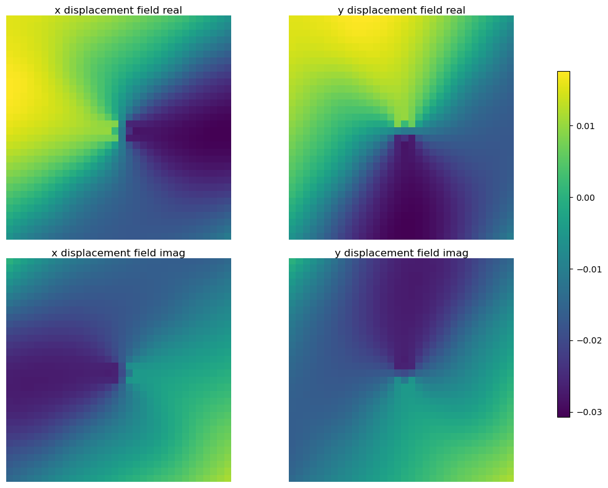
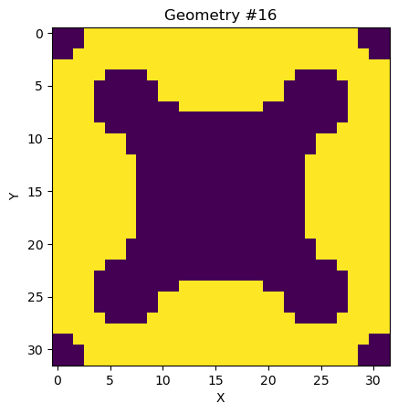
Data Prep
Displacement field data is fixed, and utility functions have been written to extract and format Caltech’s matlab data to python friendly formats.
Dataset is 400 geometries x 325 wavevectors x 6 bands = 780,000 effective samples.
Inputs are 4 panes of data, 1 pane each for a 32x32 geometry, wavevector_x, wavevector_y, and band. The latter 3 are 2D arrays of constants.
Outputs are 4 panes of data, 1 pane each for x_real, x_imag, y_real, y_imag displacement fields.

Slide 12
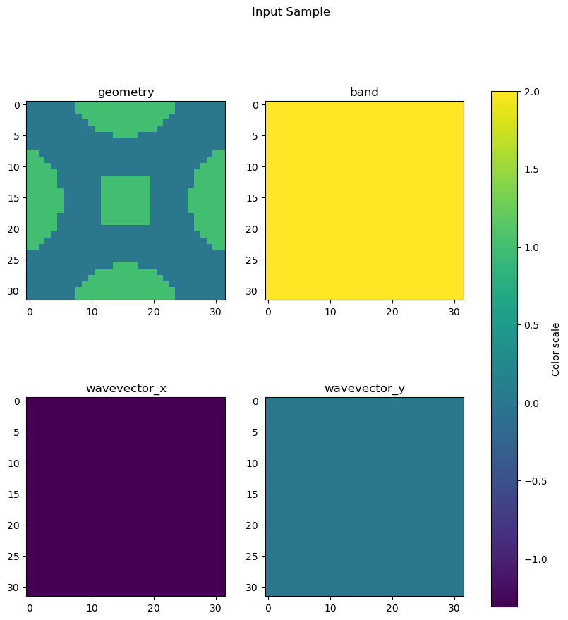
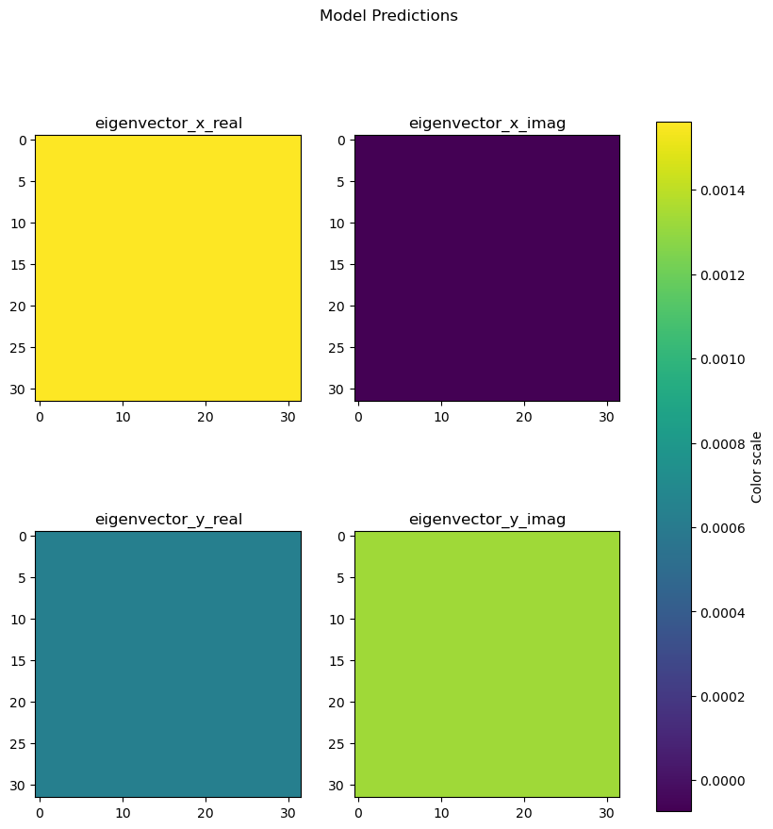
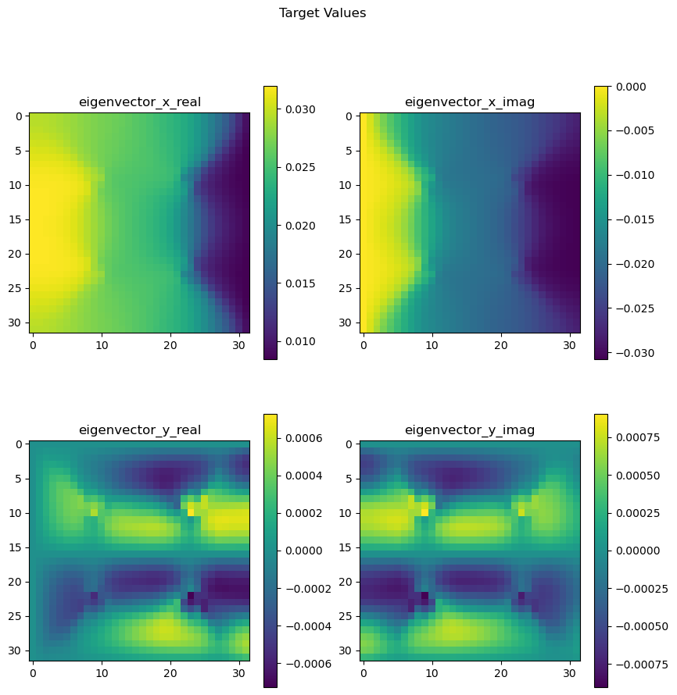
Training
Appears to have mode collapse, model is predicting something like the average value of the displacement field.
Model is a FNO with 1 lifting layer, 4 Fourier layers, and 1 projection layer.
ADAM optimizer, 10 epochs, 18282 batches/epoch, 32 samples/batch, MSE loss
Next steps: normalize data before training, increase batch size to 256.
Other potential fixes: change loss function, add layers.

Slide 13
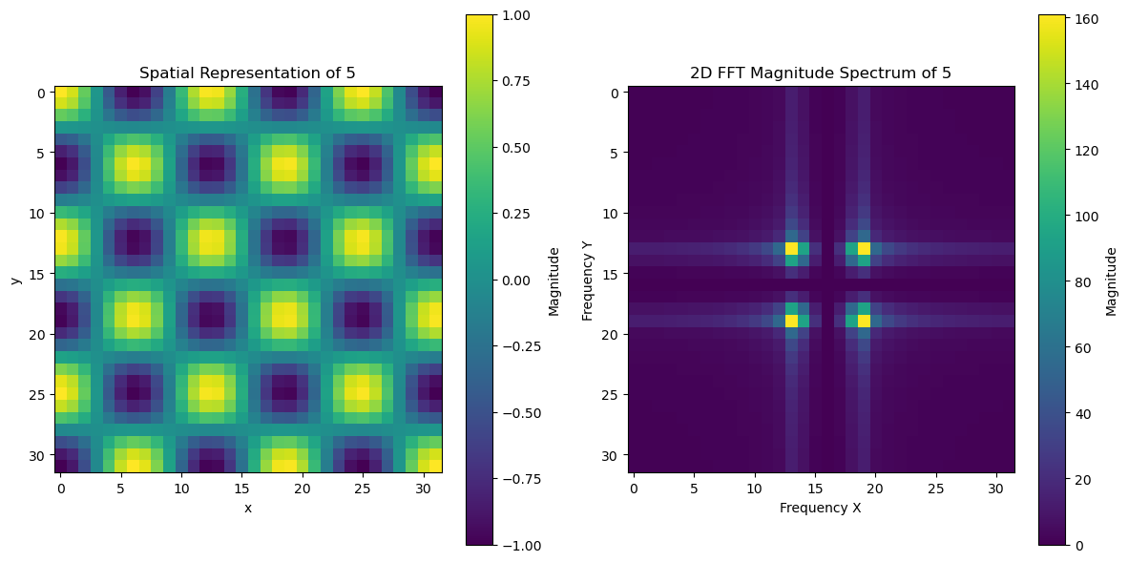
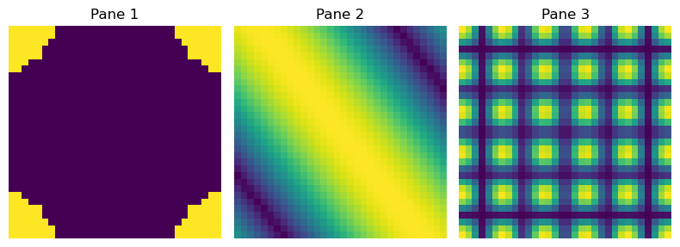
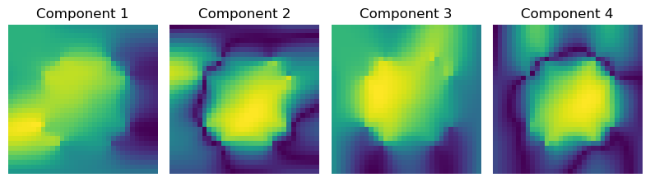
Data Representation
Revised hypothesis: because there are layers in the FNO which are doing spectral transforms, the constant panes are being reduced in information to just one pixel (one non-zero frequency), and the rest of the 2D FFT array are just 0s. Worse, the different wavevectors end up being scaled versions of each other, meaning they’re interacting with the same weights, rather than different weights in the FNO.
Revised inputs are sinusoids with spatial frequencies of wavevector const, or band const, such that their FFT transforms are much richer representations, and different wavevector/band values activate different weights in the model.
FFT
FFT
0
Sample Input
Sample Output

Slide 14
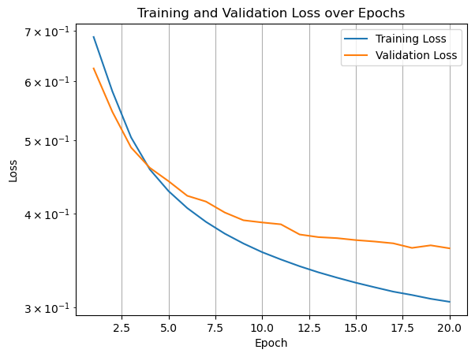
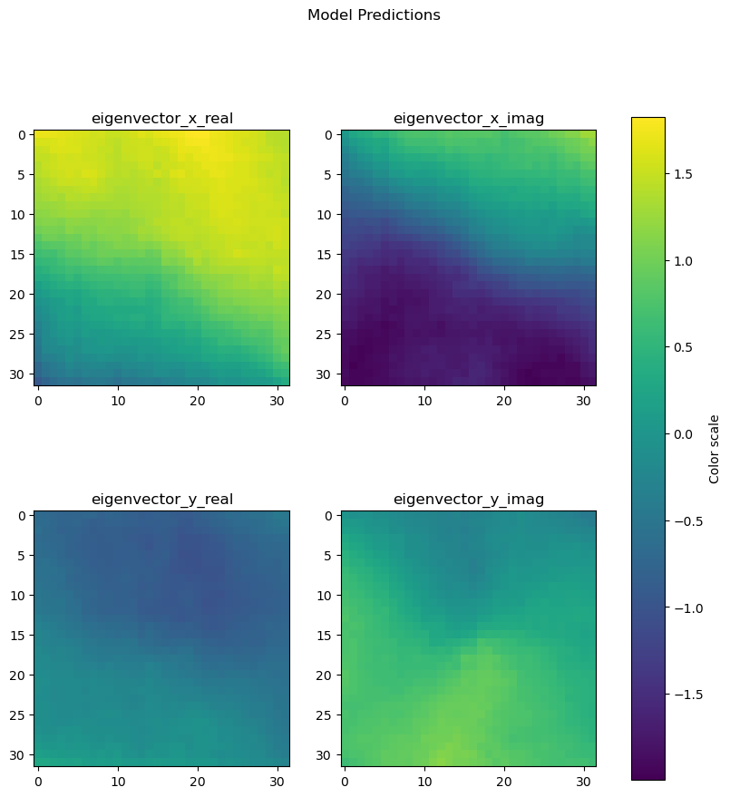
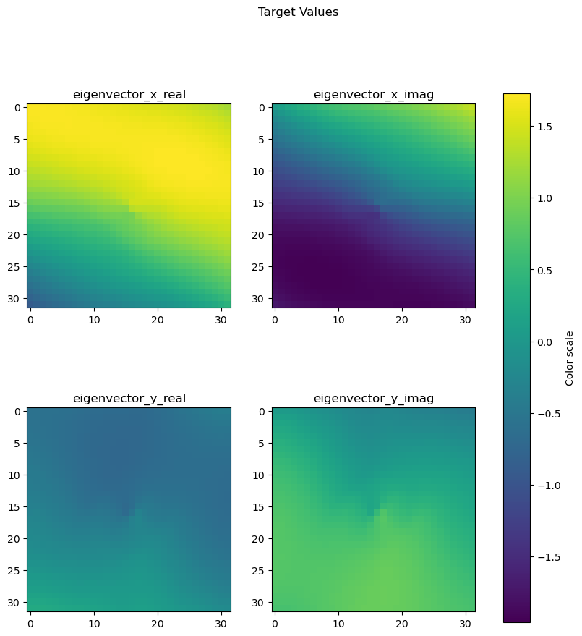
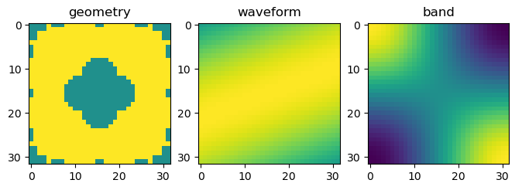
Revised Training
After normalizing data, and representing constants in frequency space, retrained model results saw massive improvements.

Slide 15
Current & future Work
Different model architectures (trying higher hidden channel count has not yielded much improvement.)
New, larger datasets (bottlenecked by RAM)
Augmented datasets (rotations, reflections)
Resolution rescaling tests
Check matlab & python combined normalization effects

Slide 16
THANK YOU, Questions?
Han Zhang

